Slide 1

Analysis of Cat and Dog Breed Datasets
Key Findings After Analysis

Slide 2

Introduction
The primary objective of this analysis is to provide a comprehensive overview of cat and dog breeds based on various metrics such as sales, popularity, temperament, and average price. By consolidating and analyzing structured data, the aim to identify trends and insights that can inform decisions related to pet breed preferences and market dynamics. The analysis includes detailed summaries, pivot charts, and identification of top and bottom breeds based on different criteria.

Slide 3

Key Metrics
The key metrics analyzed in this study includes Sales: Total and average sales figures for each breed.
Popularity: Ranking of breeds based on popularity scores.
Temperament: Analysis of common temperaments, including the mode and counts of specific traits like "affectionate."
Average Price: Calculation of average prices for the top and bottom breeds.
Counts by Category: Total counts of breeds grouped by specific categories such as fur type for cats and Group1/Group2 categories for dogs.

Slide 4
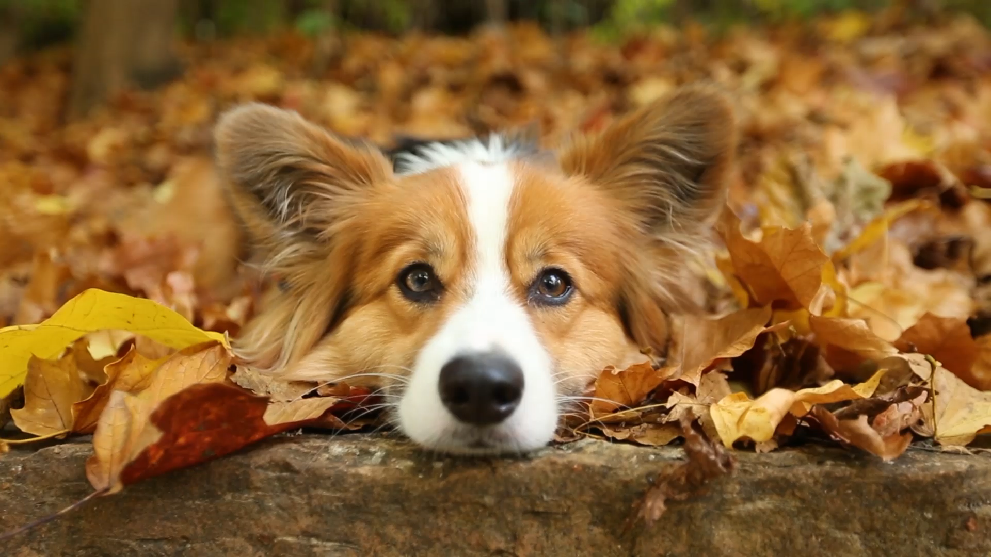
Data Source & Consolidation
The data used for this analysis is provided by Techway Placement. The data includes various attributes for each breed, such as
1. Breed Name - states the breed 2. Alt Breed Name - refers to an alternative name used to identify a particular breed 3. Group 1 - Dog breeds are categorized into different groups based on their characteristics, functions, and histories. 4. Group 2 - Dog breeds are categorized into different groups based on their characteristics, functions, and histories. 5. Male WeightKG - determines the weight 6. Temperament - determines that temperaments 7. Avg. Price - states the average price 8. Intelligence - states the intelligence level 9. Watchdog - states the watchdog level 10. Popularity - determines the popularity level, 1 being the highest 11. Qty. Sold - determines the total quantity sold
The datasets were initially in separate Excel files and needed to be consolidated into a single file. Using Excel's Full Join methods, the separate datasets were merged into one comprehensive sheet.
This combined dataset contained both cat and dog breeds in a single sheet. Two new sheets is added according the breed category where the average sales of dog and cat for each breed is calculated

Slide 5
Summary of Findings
Total counts of Cat per Fur Type
Overview: The analysis categorizes cat breeds based on their fur type, providing insights into the distribution of cat breeds with different fur characteristics.
Fur Types and Counts:
Bald :3 breeds Canadian Hairless, Sphynx (hairless cat)
Long: 20 breeds Includes breeds such as Balinese, Maine Coon, and Persian.
Medium: 14 breeds Includes breeds such as American Curl, Bengal, and Tonkinese.
Short: 30 breeds Includes breeds such as Abyssinian, Siamese, and Tuxedo.
Grand Total: A total of 66 cat breeds were analyzed, categorized by their fur type.
Key Insights: The majority of cat breeds fall under the "Short" fur type category.
"Long" fur type is the second most common category, followed by "Medium" and "Bald."

Slide 6
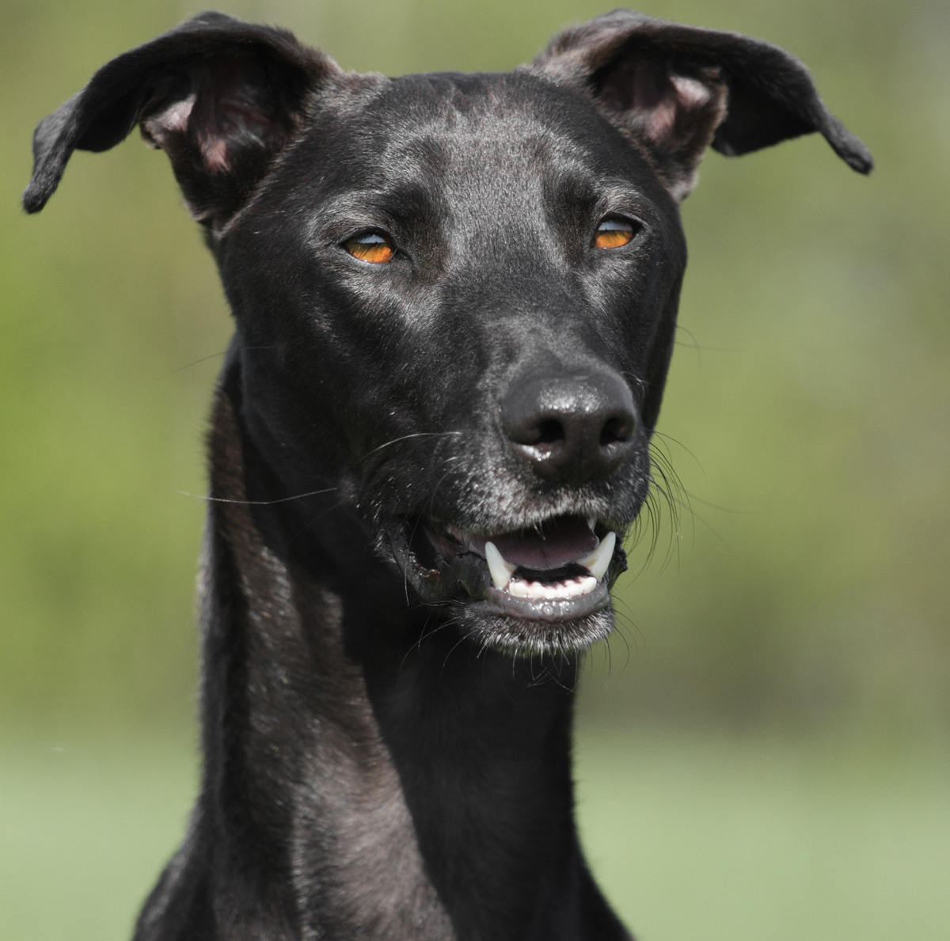
Total Count of Dogs per Group1 Category
Overview: The analysis categorizes dog breeds based on their Group1 category, providing insights into the distribution of dog breeds across different groups.
Group1 Categories and Counts:
Herding: 37 breeds Includes breeds such as Australian Cattle Dog, Border Collie, and German Shepherd Dog.
Hound: 34 breeds Includes breeds such as Beagle, Bloodhound, and Greyhound.
Non-Sporting: 27 breeds Includes breeds such as Bichon Frise, Dalmatian, and French Bulldog.
Southern: 1 breed New Guinea Singing Dog.
Sporting: 40 breeds Includes breeds such as Labrador Retriever, Golden Retriever, and Cocker Spaniel.
Terrier: 36 breeds Includes breeds such as Airedale Terrier, Bull Terrier, and Jack Russell Terrier.
Toy: 21 breeds Includes breeds such as Chihuahua, Maltese, and Pomeranian.
Working: 48 breeds Includes breeds such as Boxer, Great Dane, and Rottweiler.
Grand Total: A total of 244 dog breeds were analyzed, categorized by their Group1 category.
Key Insights: The "Working" group has the highest number of breeds, followed by the "Sporting" and "Herding" groups.
The "Southern" group has the least number of breeds, with only one breed represented.

Slide 7
Popularity Analysis
Dog Breed
Cat Breed
The "Norwegian Lundehund" is the most popular breed in the dataset followed by Hound .
The "Sloughi" is the most popular breed in this dataset.

